Slide 1
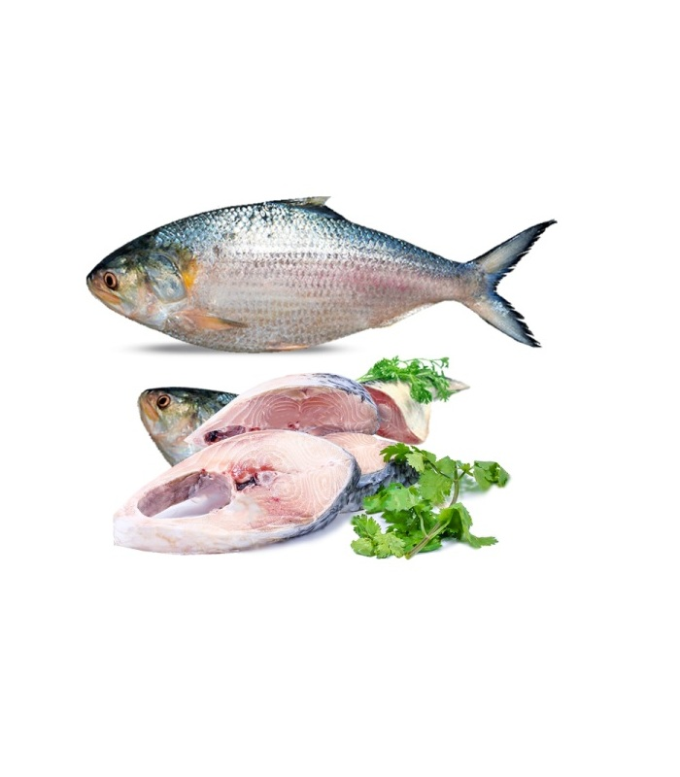
Dhaka Fish
Supply

Slide 2
gtfretyr

